Slide 1
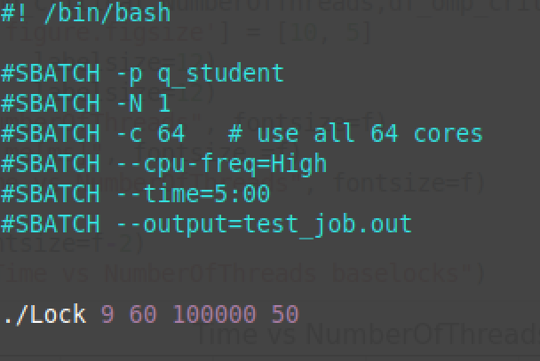
We go up to 60 threads
We let every thread configuration run 50 times
We traverse all lock implementations up to the 9. lock
We let the CS run 1e5 times

